Slide 1

MATRIX OPERATION System
Presentation By :
K.Vinootna - 25B11AI618
I.Chaitrika Sri - 25B11AI715
V.Deekshitha - 25B11AIC54
M.Madhu Shalini - 25B11AI758
Under the Supervision of T.Vijaya Lakshmi(M.TECH) Assistant Professor
Department of AIML

Slide 2

Index
✓ ✓ ✓ ✓ ✓ ✓ ✓ ✓ ✓ ✓
Abstract
Introduction
Problem Statement
Objectives of Project
Users of the system Modules/Functionalities Architecture Diagram
ER Diagram / DFD
Planning and Timeline Diagram Role of each individual

Slide 3
ABSTRACT
Matrix Operation System
  A Matrix Operation System is a system designed to perform mathematical operations on matrices efficiently and accurately.
  It supports basic operations such as matrix addition, subtraction, multiplication, and transpose.
  The system simplifies complex matrix calculations and reduces manual effort.
  It helps minimize calculation errors and saves time when working with large matrices.
  The system can be used in engineering, computer science, data analysis, and scientific applications.
  The main objective is to provide a simple, user-friendly, and efficient way to perform matrix operations.

Slide 4
INTRODUCTION
Matrix Operation System
  A Matrix Operation System is a C++-based application designed to perform different mathematical operations on matrices.
  It allows users to enter matrix elements and select the required operation through a simple menu.
  The system performs calculations such as addition, subtraction, multiplication, and transpose.
  It checks matrix dimensions to ensure that the selected operations can be performed correctly.
  By using Object-Oriented Programming concepts, the system organizes matrix operations into reusable and manageable functions.
  The system displays the results in a clear format, making matrix calculations easier to understand and perform.
  It provides a practical way to apply C++ programming concepts to solve mathematical problems.
4

Slide 5
PROBLEM STATEMENT
Performing matrix operations manually can be time-consuming and may lead to calculation errors, especially when dealing with large matrices. A simple and efficient system is needed to perform matrix calculations accurately and reduce manual effort.
Challenges in Manual Matrix Operations:
  Time-consuming calculations for large matrices.
  Possibility of human errors during repeated operations.
  Difficulty in managing multiple matrix operations.
  Manual calculations are difficult to verify.
  Lack of a simple, organized approach to perform operations efficiently.
5

Slide 6
OBJECTIVES
The main objectives of the Matrix Operation System are:
  To develop a matrix calculation system using C++.
  To perform matrix operations accurately and efficiently.
  To reduce manual calculation time and errors.
  To apply Object-Oriented Programming concepts in a practical application.
  To provide a simple and user-friendly menu-driven interface.
  To organize matrix operations using classes and member functions.
  To display clear and accurate results for different matrix operations.
6

Slide 7
USERS
USER GROUP | PURPOSE / KEY RESPONSIBILITY
Students | To perform matrix calculations for academic purposes.
Teachers / Faculty | To explain matrix operations and verify results.
Programmers / Developers | To develop and test matrix-based programs
Engineers | To perform mathematical and engineering calculations.
Researchers | To use matrix operations in scientific research.
Data Analysts | To apply matrix operations in data processing.
7

Slide 8
MODULES/FUNCTION ALITIES
  Input Module: Accepts matrix dimensions and elements from the user.
  Validation Module: Checks matrix dimensions and validates input values.
  Addition Module: Performs addition of two matrices of the same order.
  Subtraction Module: Performs subtraction of two matrices of the same order.
  Multiplication Module: Performs matrix multiplication using rows and columns.
  Transpose Module: Converts matrix rows into columns and columns into rows.
  Result Module: Displays the output of the selected matrix operation.
  Reset / Exit Module: Allows users to clear inputs or exit the system.
8

Slide 9
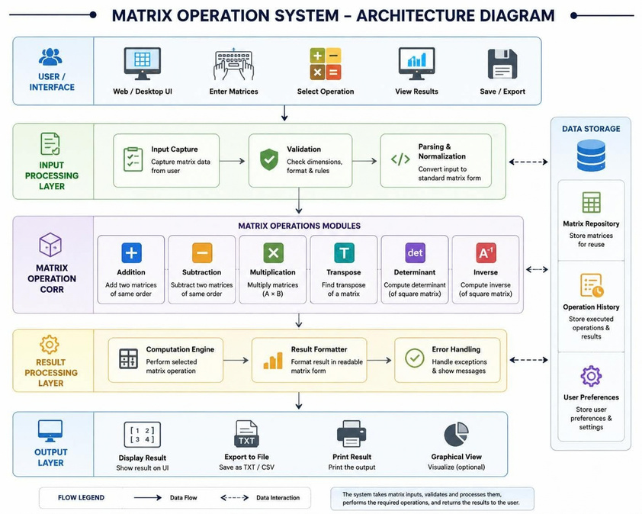
ARCHITECTURE
DIAGRAM
9

Slide 10
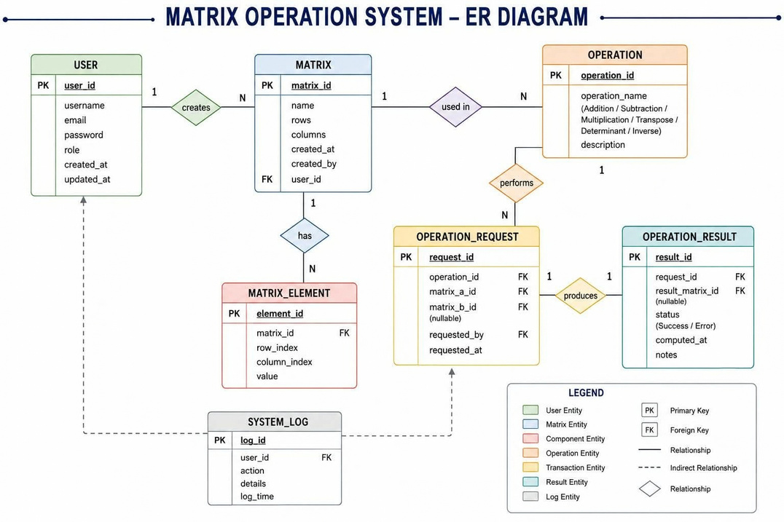
ER DIAGRAM
10

Slide 11
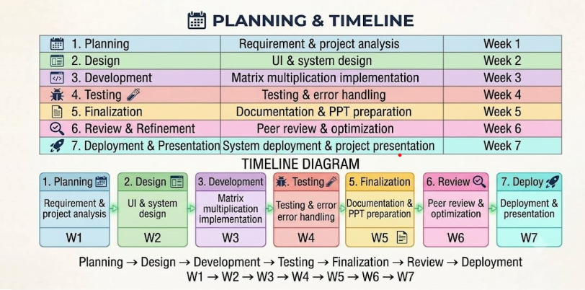
PLANNING &
TIMELINEDIAGRAM
11

Slide 12
ROLE OF EACH
INDIVIDUAL
V.DEEKSHITHA :​
📑 Slides: 4–6​
🎯 Role: Users, Modules & Functionalities, System Design​
M.MADHU SHALINI :​
📑 Slides: 1–3​
🎯 Role: Introduction,​
Problem Statement, Objectives​
I.CHAITRIKA SRI :​
📑 Slides: 7–9​
🎯 Role: Algorithm, Matrix Multiplication Process, Implementation​
​
K.VINOOTNA :​
📑 Slides: 7–9​
🎯 Role: Algorithm, Matrix Multiplication Process, Implementation​
​
12

Slide 13
Thank You
13

